Slide 1
AIRLINE RESERVATION SYSTEM
DBMS PROJECT
Tech Used
HTML,CSS,JS
PHP, MySQL
Shivansh Bhardwaj
2017UCP1515
Site URL :
udaanbharo.epizy.com

Slide 2
Acknowledgement
This is a certified work done by Shivansh Bhardwaj under the guidance of Dr. Namita Mittal.
Sources Used:
wikipedia,w3schoos,geeksforgeeks,google flights,stackoverflow

Slide 3
About Project
A demo of Airline Reservation System with Customer and Admin login
Customer Can:
Book Flight Tickets for a particular date between selected cities
View booked tickets
Cancel booked Tickets
Admin Can:
Add new jet
Add new flight
Cancel a flight
View booked ticket Statistics

Slide 4
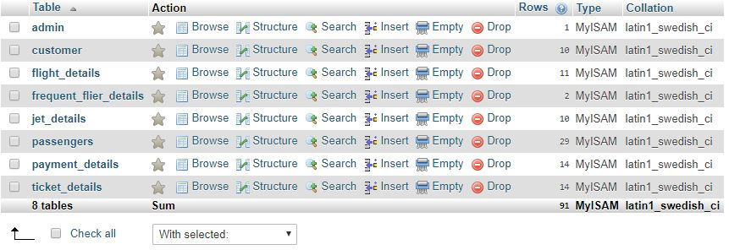
Tables Used

Slide 5
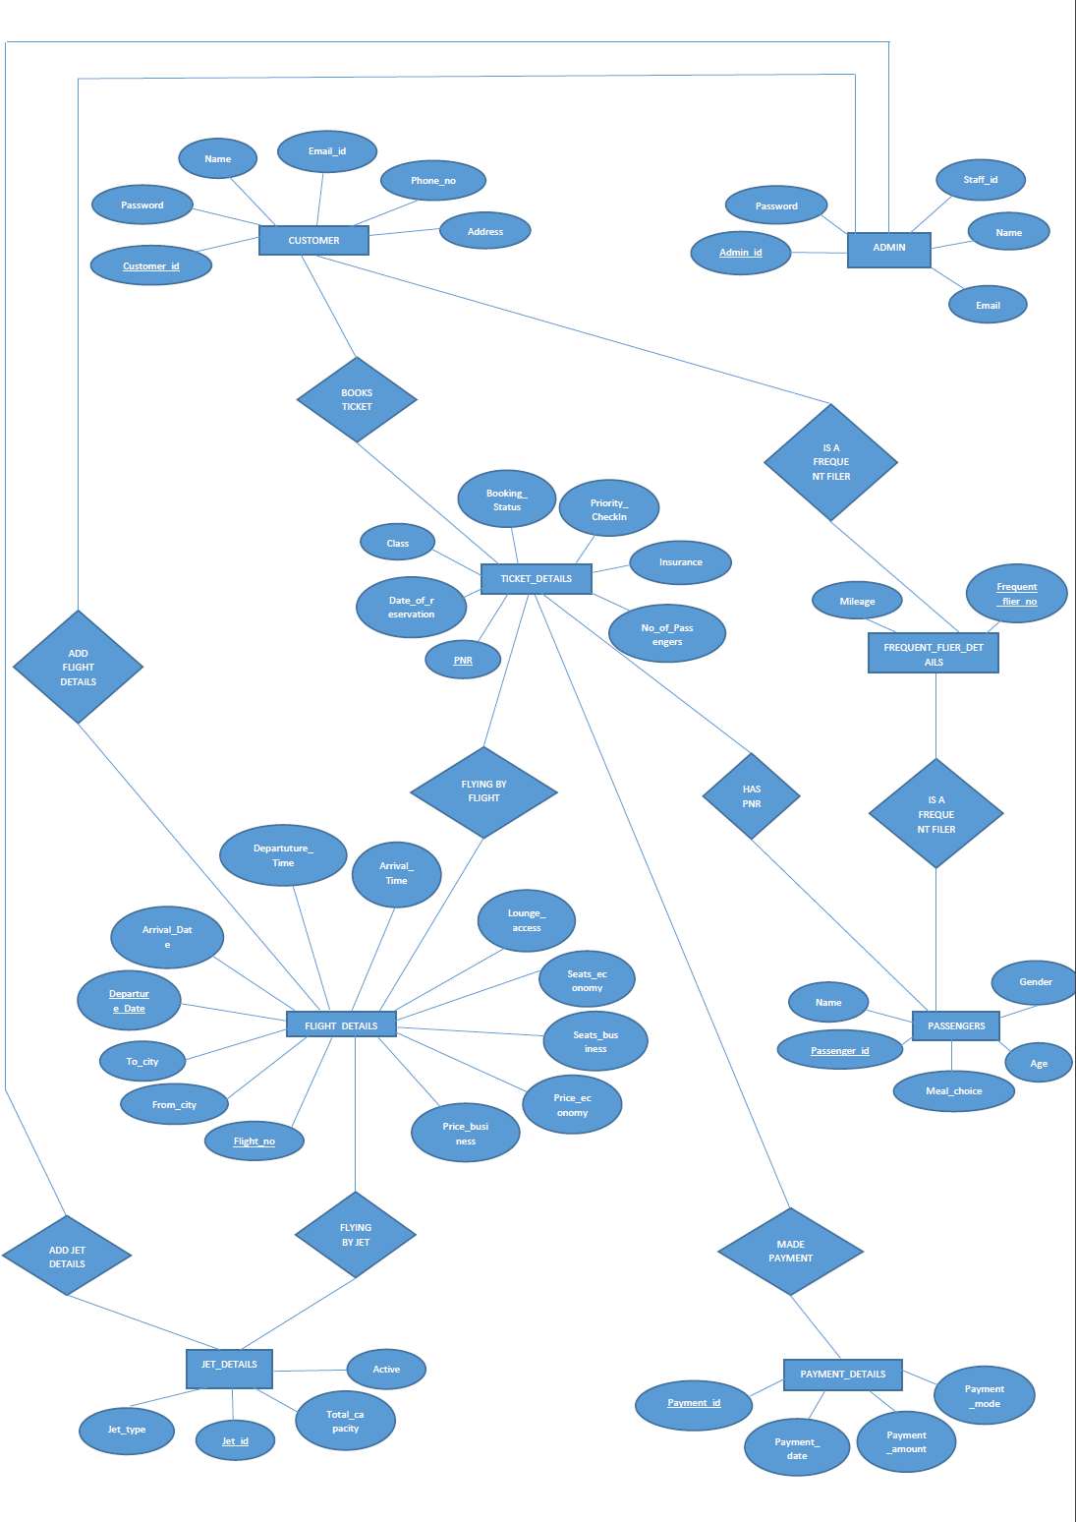

Slide 6
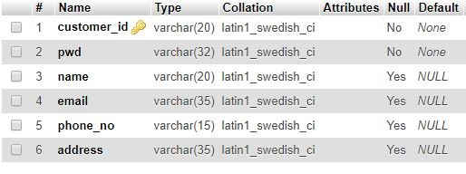
Logical Schema –(Customer)
Functional Dependecies:
customer_id->
pwd,name,email,phone_no,address
Bcnf Form

Slide 7
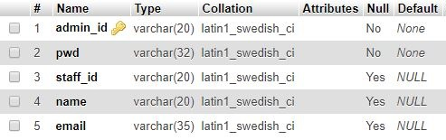
Logical Schema –(Admin)
Functional Dependecies:
admin_id->
pwd_type,staff_id,name,email
Bcnf Form

Slide 8
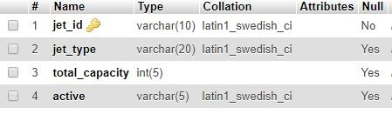
Logical Schema – (Jet Details)
Functional Dependecies:
jet_id->
jet_type,jet_type,total_capacity,active
Bcnf Form

Slide 9
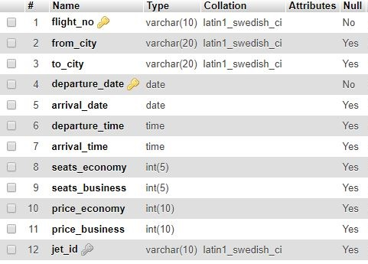
Logical Schema – (Flight Details)
Functional Dependecies:
flight_no,departure_date->
from_city,to_city,arrival_date,departure_time,arrival_time,seats_economy,seats_business,price_economy,price_business,jet_id
Bcnf Form

Slide 10
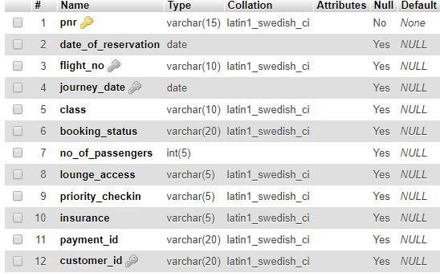
Logical Schema – (Ticket Details)
Functional Dependecies:
pnr->
date_of_reservation,flight_no,journey_date,class,booking_status,no_of_passengers,lounge_access,priority_checkin,insurance,payment_id,customer_id
Bcnf Form

Slide 11
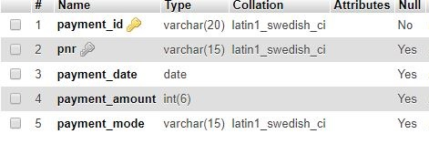
Logical Schema – (Payment Details)
Functional Dependecies:
payment_id->
pnr,payment_date,payment_date,payment_amount,payment_mode
Bcnf Form

Slide 12
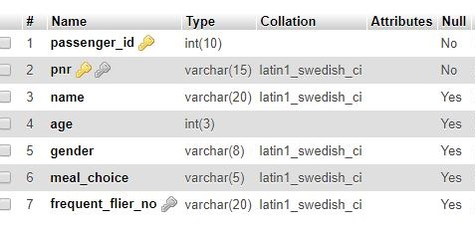
Logical Schema –(Passenger Details)
Functional Dependecies:
passenger_id,pnr->
name,age,gender,meal_choice,frequent_flier_nos
Bcnf Form

Slide 13
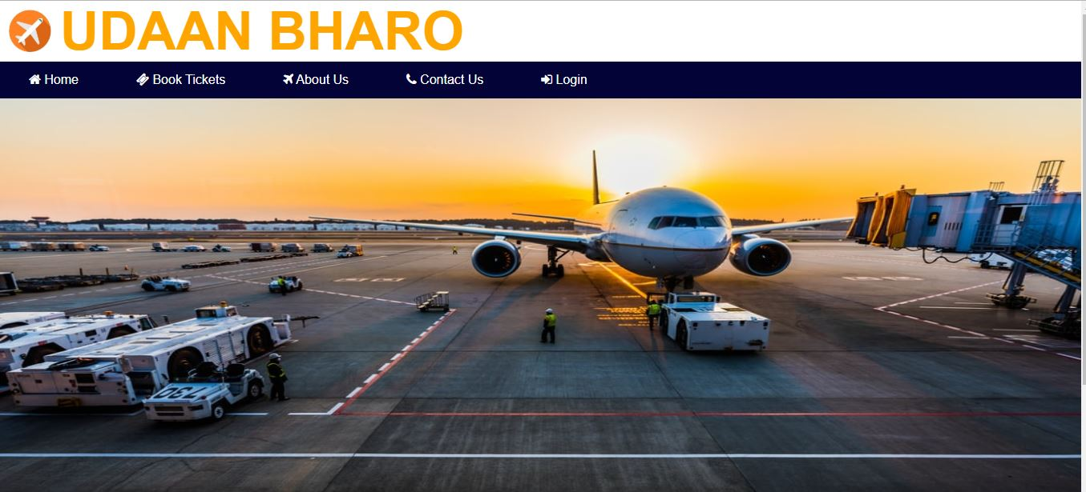

Slide 14
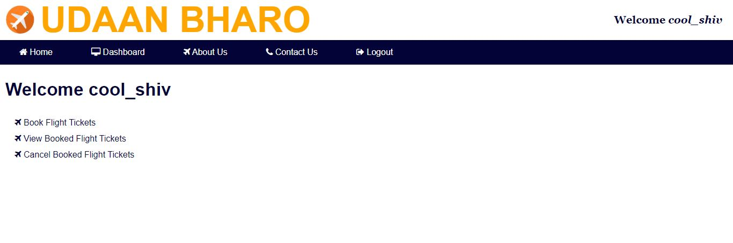
User Dashboard

Slide 15
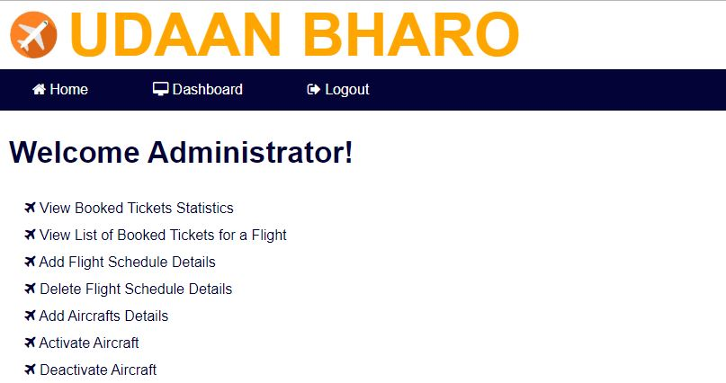
Admin Dashboard

Slide 16
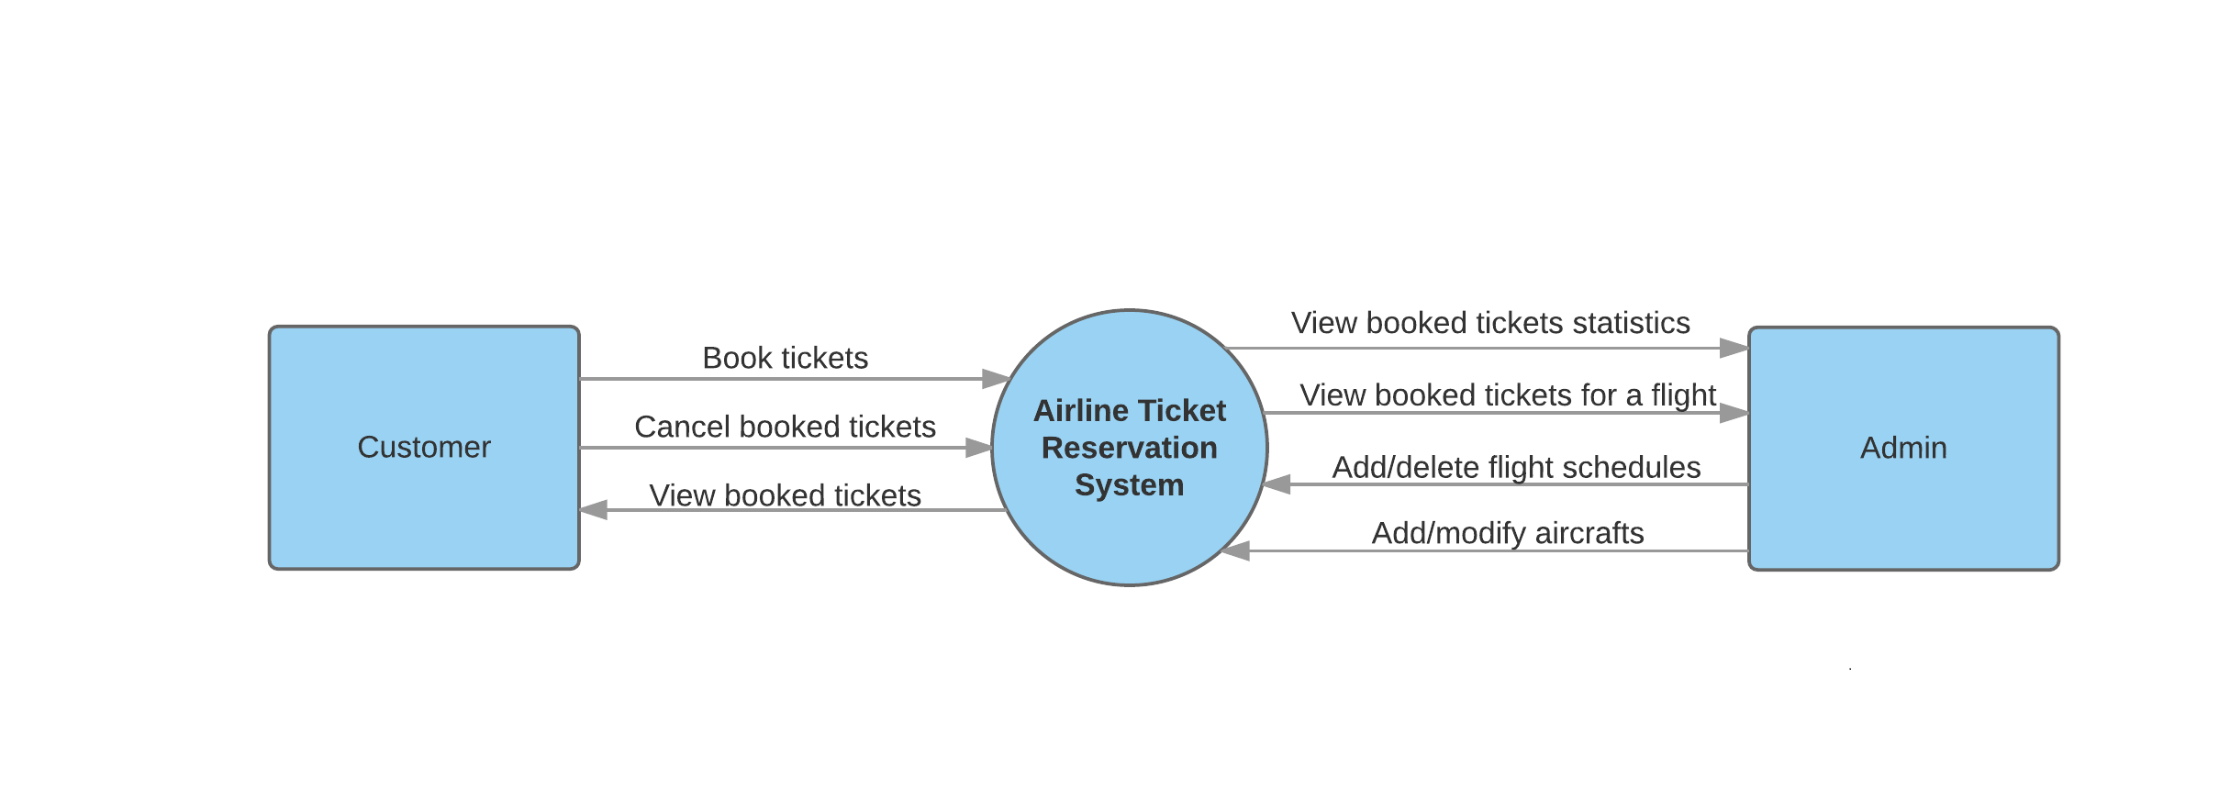
DATA FLOW DIAGRAM

Slide 17
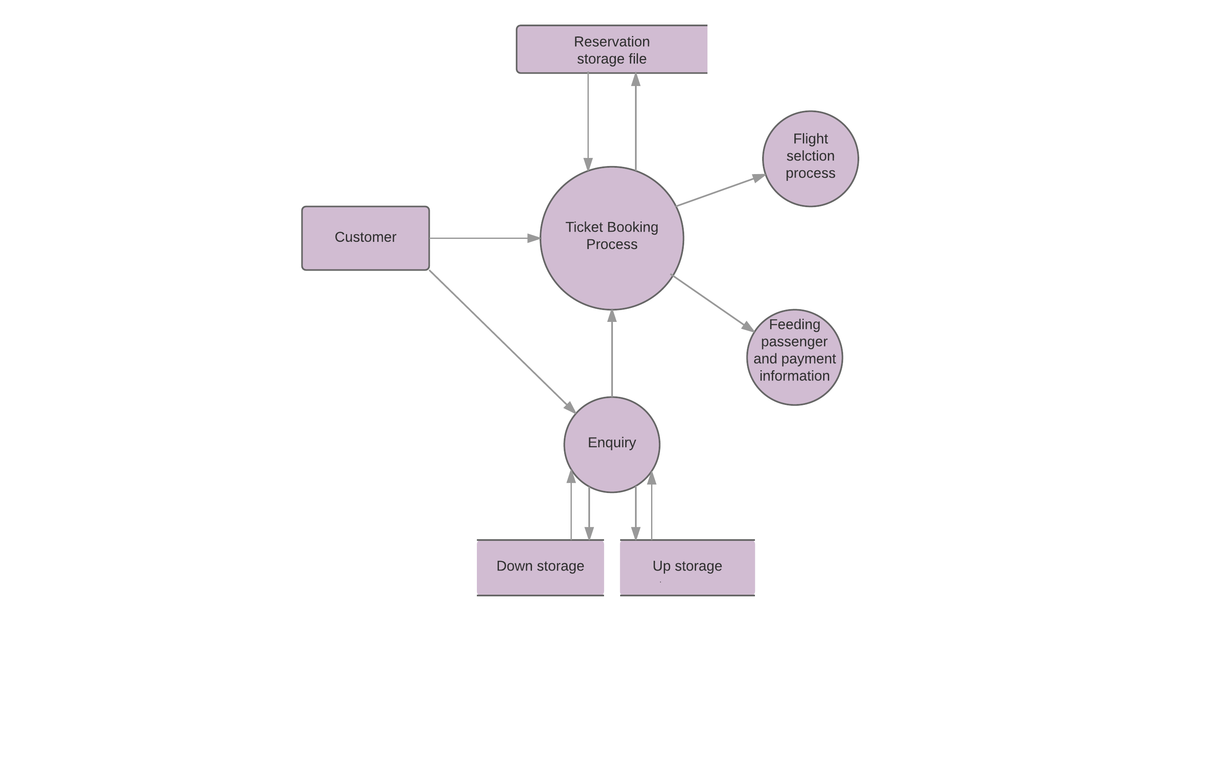
DATA FLOW DIAGRAM (Advanced)

Slide 18
THANK YOU

